Slide 1

The Impact of Maternal Education on Child Malaria Rates
25/05/2024

Slide 2


Our Team
Other Active Members
Name: Ayodeji Saberedowo
Name: Adeleye Kayode
Name: Christian Utsu
Name: Ibifaka Campbell
Name: Fajemisin Adeniyi
Name: Olubola Titilope Adegbosin
Usman Hassan
Abdur-Rahman Olaniyan
Role: Presenter 1
Role: Presenter 2
Project Lead
Name: Bamidele Faith
Assistant Project Lead
Name: Wellspring Praise
Query Analyst
Name: Blessing Domola

Slide 3
Problem Statement
Despite efforts, malaria remains a major health issue in many regions. This project explores the impact of maternal education on reducing child malaria rates, lacking comprehensive analysis.
Malaria persists as a significant health challenge. This study investigates whether higher maternal education correlates with lower child malaria rates, filling the gap in detailed analysis.
Malaria continues to affect many regions severely. This project aims to provide detailed evidence on how maternal education can reduce child malaria rates, informing targeted interventions..

Slide 4
Existing Solutions
Previous studies, such as Joseph D. Njau (2014), have explored the statistical relationship between maternal education and childhood malaria infection. These studies aimed to highlight these relationships and inform strategies to reduce the disease burden among children.
The previous solution did not specifically address the levels of maternal education and instead generalized across all childhood ages and regions. However, children under five are particularly vulnerable, constituting 70% of malaria deaths, necessitating a focused approach on this age group and regional variations.

Slide 5
Our approach
Data Gathering: We obtained the dataset from UNICEF's official website https://data.unicef.org/topic/child-health/malaria/, which provided comprehensive data on child health and malaria.
Data Description/Used: The dataset consisted of 17 sheets, and we carefully selected the three most relevant sheets that aligned with our project's objectives. This ensured that our analysis was focused and effective.
Data Visualization: We utilized the Seaborn library's histogram function to visualize the correlation between mothers' educational levels and their children's malaria rates. This visualization provided valuable insights into the relationship between these variables.
Model Training: To further explore and validate our findings, we used Linear regression model for get pattern from our dataset and we divided the dataset into training and testing sets. We used the mother's education level as the dependent variable and the National column as the independent variable.
Model Evaluation: We employed the coefficient of determination (R-squared) to assess the strength of the relationship between the trained and test variables.

Slide 6
Dataset Description
Data Collection and Preparation
Source: UNICEF Data
Sheets Used: MLRCARE, MLRDIAG, MLRACT
Data Wrangling/EDA
Handled null values, duplicates, and filtered necessary indicators. Each sheet was cleaned and analyzed separately
Data Description
Key Features: Country code, country names, UNICEF reporting and program regions, World Bank income groups, Year, data sources, Malaria infection rates, Gender distribution, Rural and urban populations, Income groups, Maternal education levels
Data Visualization
Tools Used : MatplotLib And Seaborn
Key Observations :
MLRCARE: Percentage of children (under age 5) with fever for whom advice or treatment was sought.
MLRDIAG: Malaria Diagnostic Usage - Percentage of febrile children (under age 5) who had malaria diagnosis.
MLRACT: First-line treatment (ACT) for children under age 5 with fever-
Data Modelling
Algorithm Used: Linear regression
Evaluation Metrics: Mean Absolute Error (MAE), r2_score and Root Mean Square Error (RMSE) to assess model performance.

Slide 7
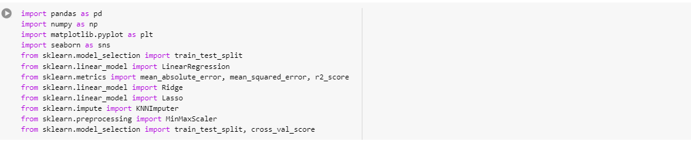
Model
Linear Regression was chosen as the modeling technique, proving to be the most suitable approach for our dataset. The coefficients generated by the model revealed a significant correlation between maternal education level and children's malaria rate. This analysis enabled us to draw meaningful conclusions about the impact of maternal education on children's health outcomes, specifically in regards to malaria rates. The model's results provided a deeper understanding of the relationship between these variables, supporting our project's objectives.
Step 1: We initiated our analysis by importing the necessary libraries, including Matplotlib, Seaborn, and Pandas, to facilitate data manipulation and visualization..

Slide 8
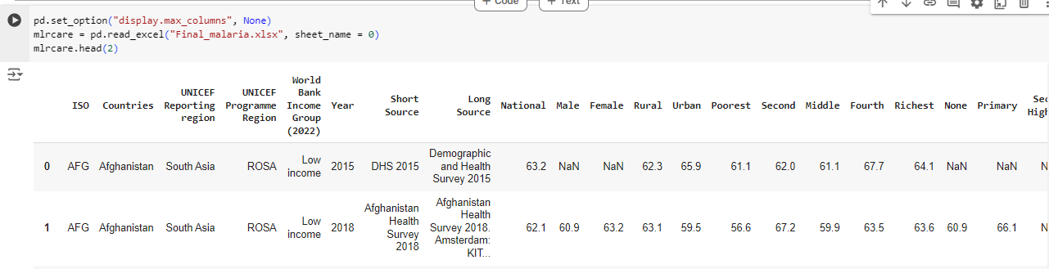
Model
Step 2: We began by examining the provided dataset, focusing on the three relevant sheets that contained the data for our correlation analysis. This step enabled us to understand the structure and content of the data.

Slide 9
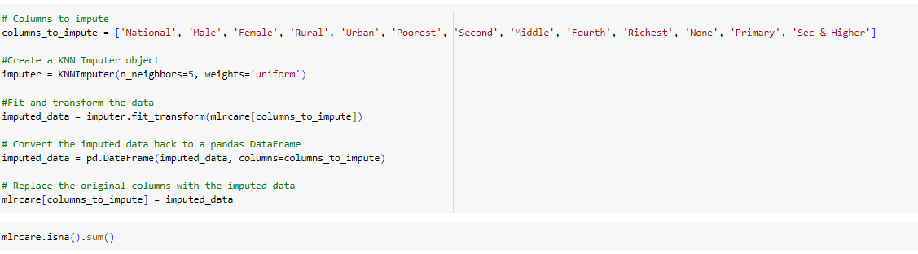
Model
Step 3: We cleaned the dataset by removing columns that were deemed irrelevant to our analysis, ensuring a more focused and efficient exploration of the data.
Step 4: Using KNN impute to Handle missing values because each entity has different pattern of values.

Slide 10
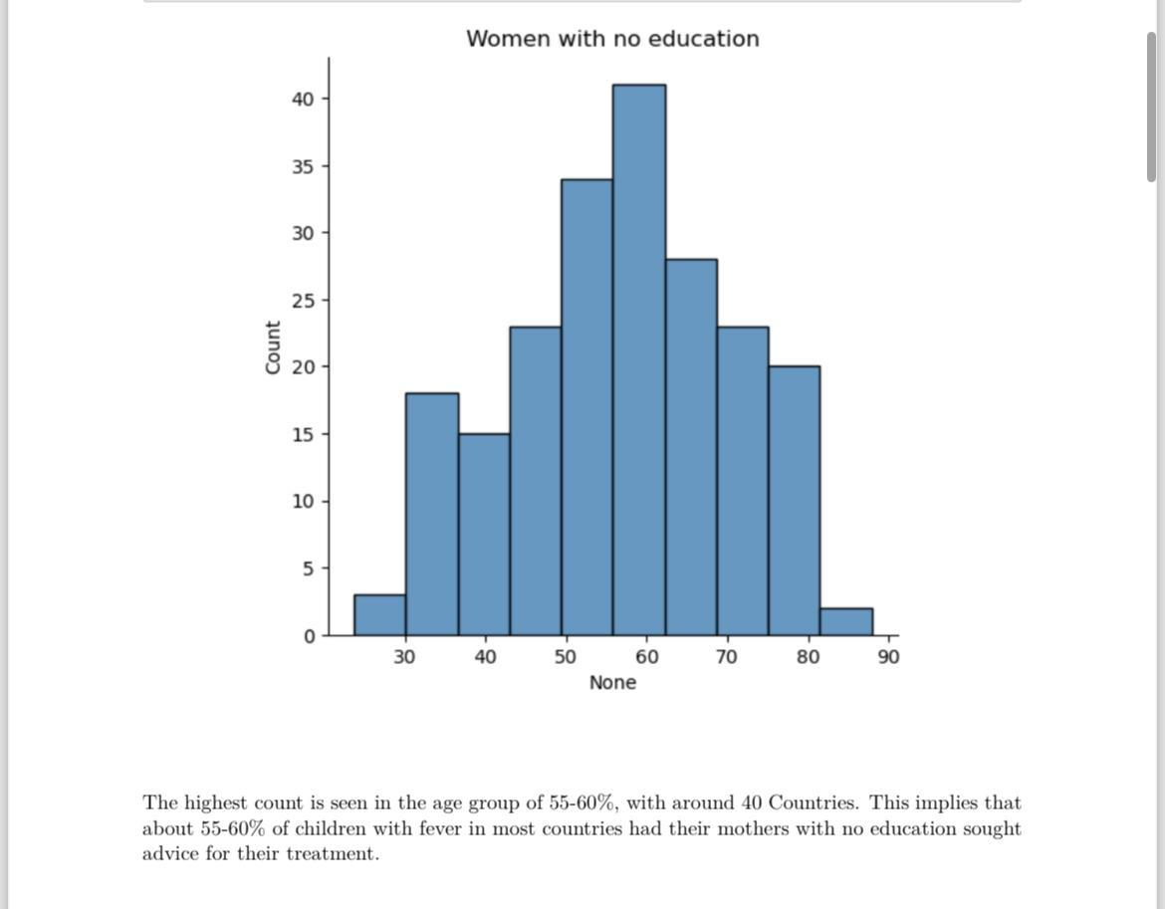
Model
Step 5: We created visualizations for each of the three sheets to gain a deeper understanding of the data distribution and relationships.
MLRCARE - Percentage of children (under age 5) with fever for whom advice or treatment was sought.

Slide 11
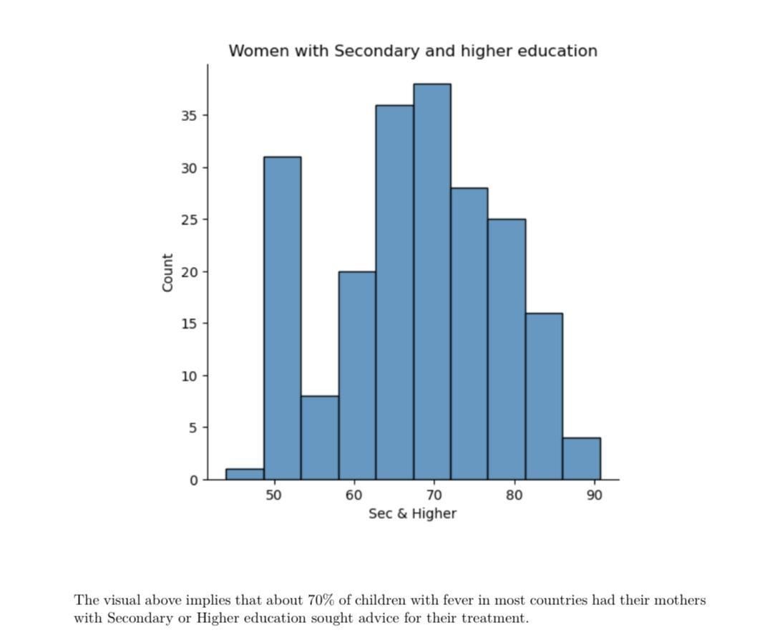
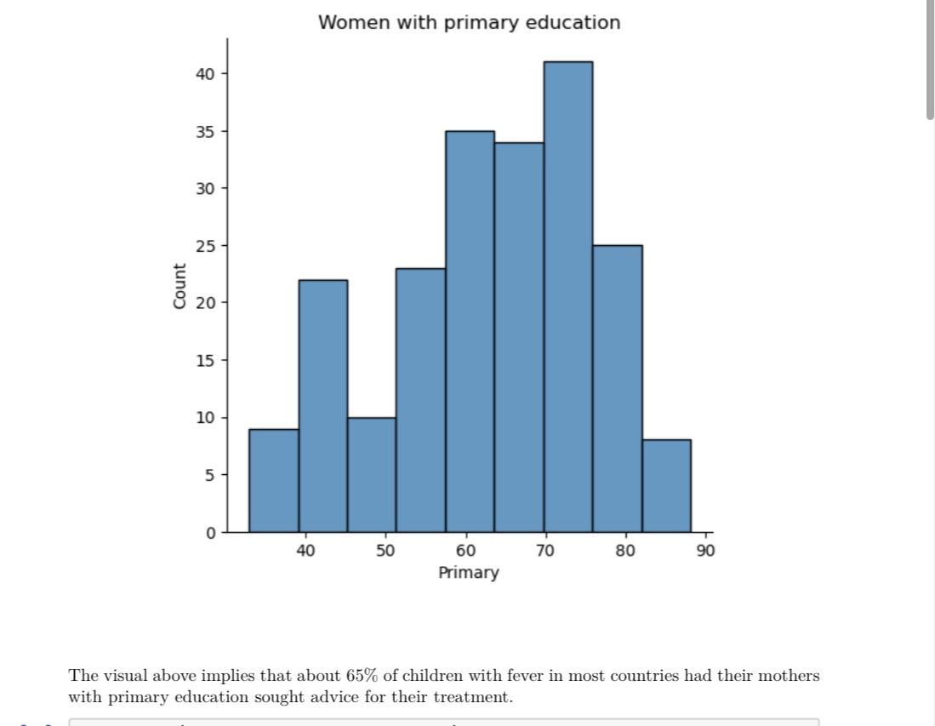
Model

Slide 12
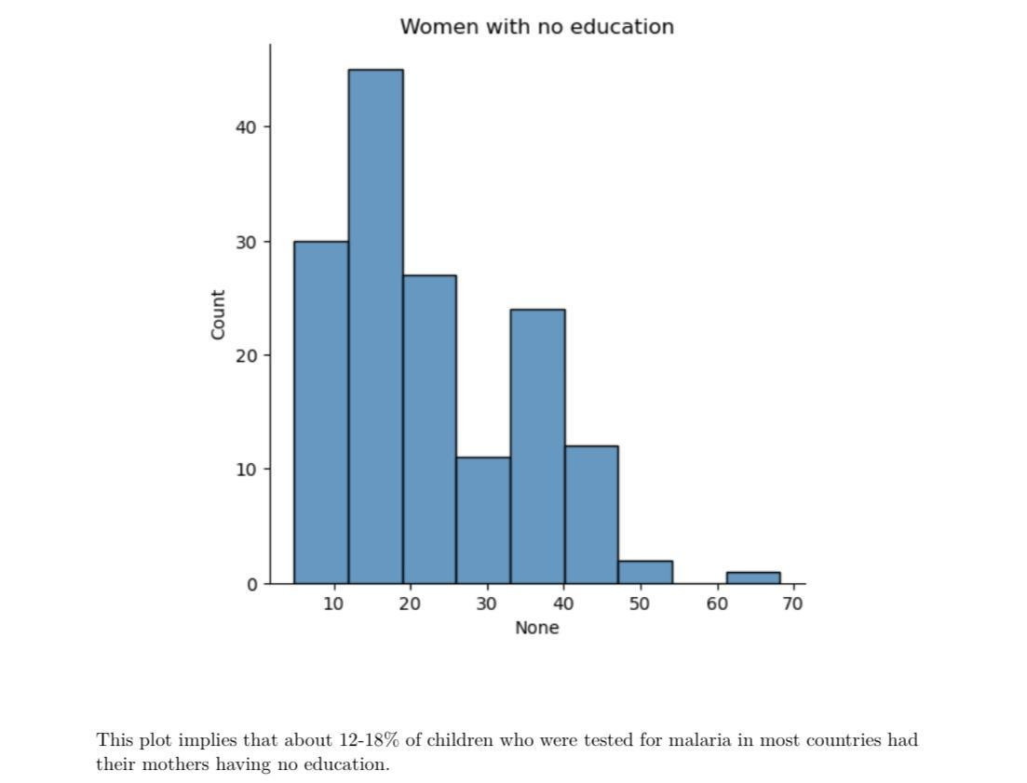
Model
MLRDIAG - Malaria Diagnostic Usage - Percentage of febrile children (under age 5) who had malaria diagnosis.
The visualization below analyses our second sheet.

Slide 13
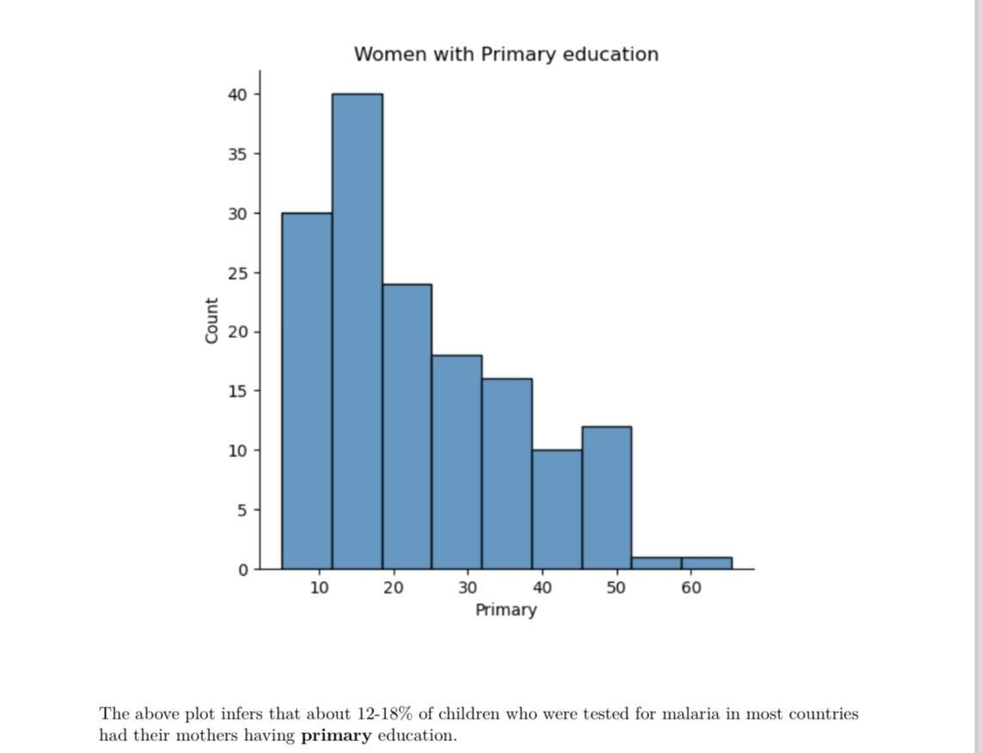
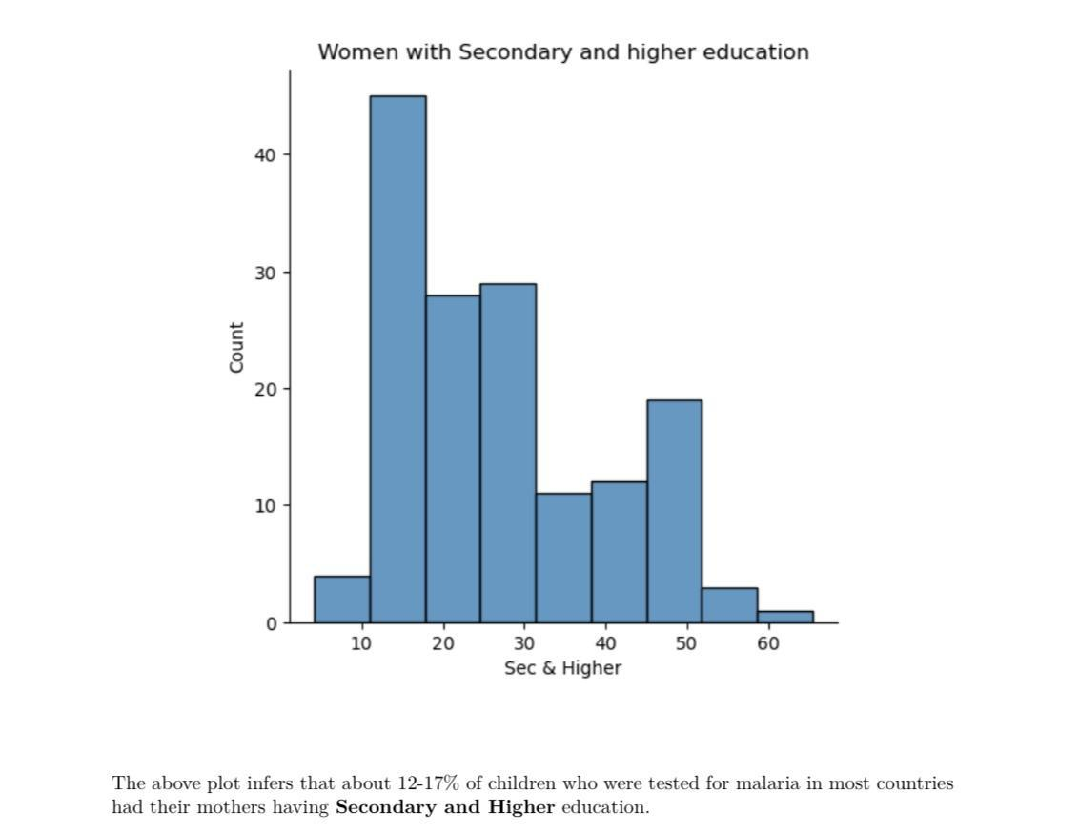
Model

Slide 14
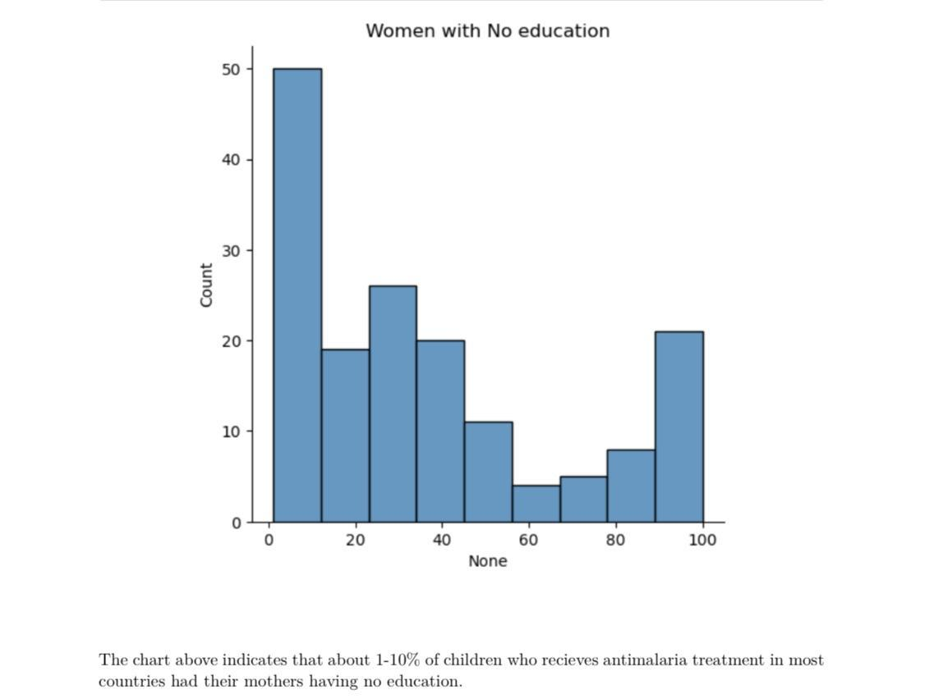
Model
MLRACT - First-line treatment (ACT) for children under age 5 with fever- Percentage of febrile children (under age 5) receiving ACT (first-line anti- malarial drug), among those receiving any antimalarial drugs. This is our third sheet. The visualization below analyses our third sheet.

Slide 15
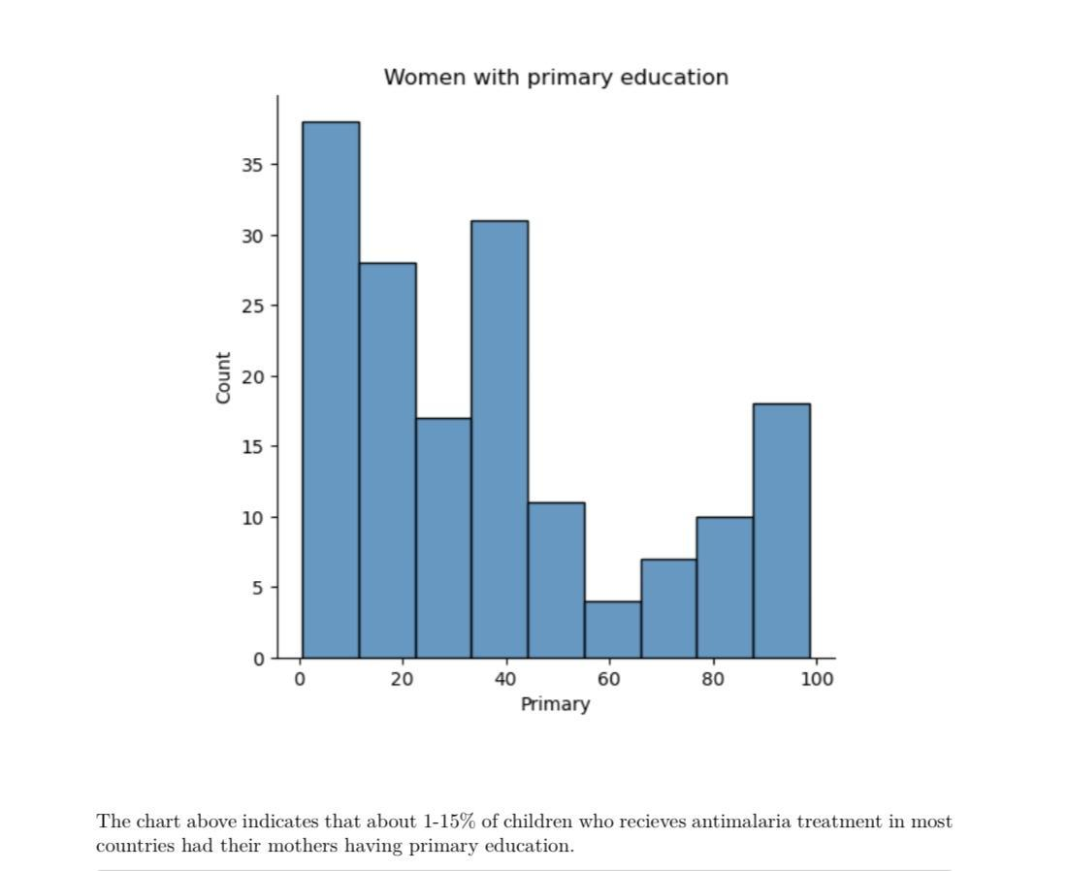
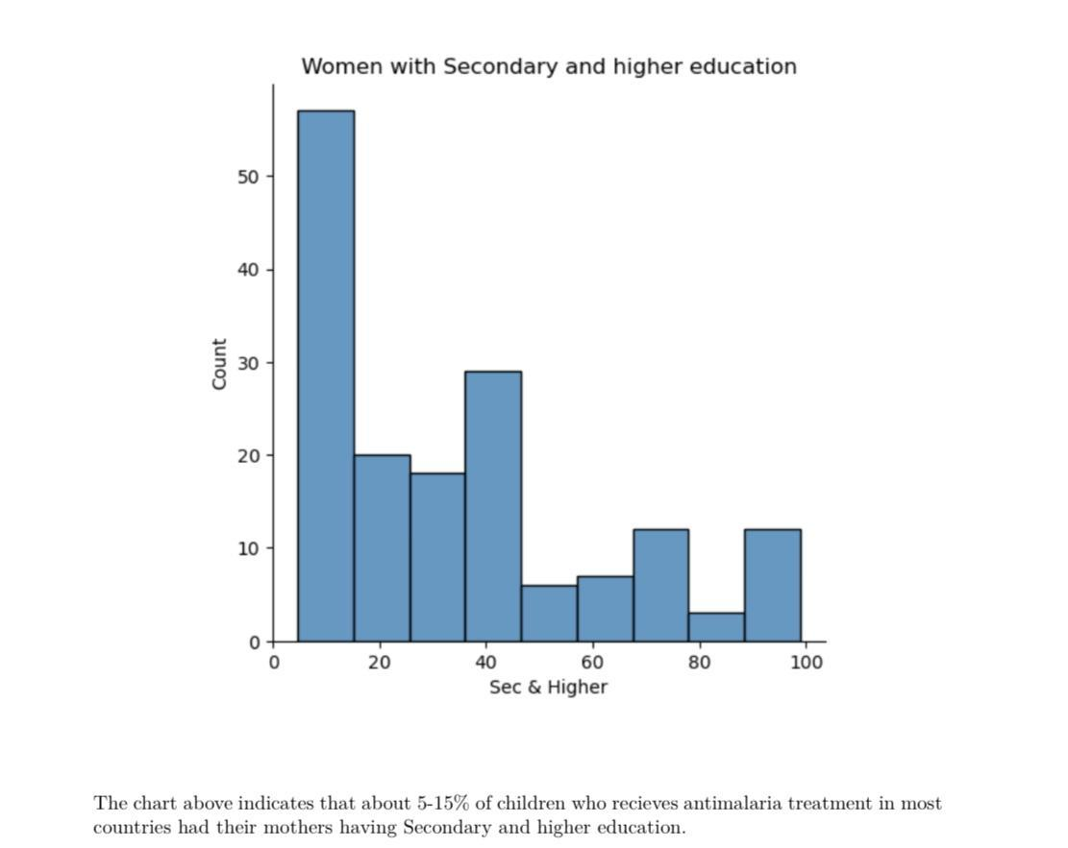
Model

Slide 16
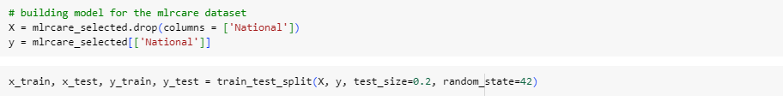
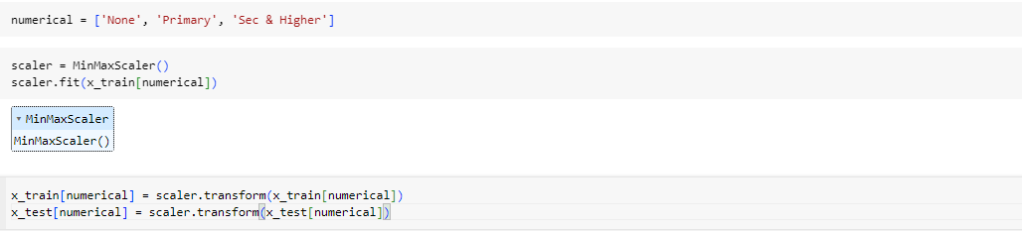
Model
Step 6: We divided the dataset into training and testing sets to ensure model robustness and generalizability thereby reducing the risk of overfitting and improving reliability.
Step 7: MinMaxScaler - a specific technique for normalization, was used to scale the values to a common range to prevent feature dominance.

Slide 17
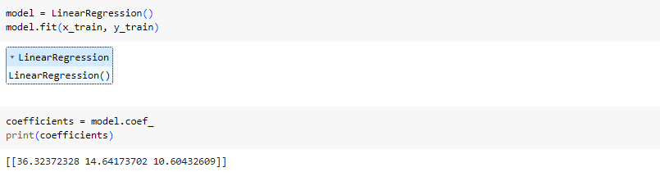
Model
Step 8: We employed linear regression, calculating the coefficient of determination (R-squared) to assess model performance and the strength of the correlation between maternal education level and children's malaria rate.
From the model, we got 3 different coefficients, which indicated the coefficients of (None, Primary, Sec & Higher) variables respectively. The whole procedures were performed to the three sheets we used and it provided a deeper relationship into the effects of maternal education on the rate of malaria on children.

Slide 18
Summary
Our project was aimed to address a critical public health issue by investigating the impact of maternal education on child malaria rates. Through this research, we were able to uncover valuable insights into how a mother's educational attainment can significantly influence her children's health, particularly in malaria-prone regions.
This datasets had seventeen excel sheets. It was very difficult for us to decide which of the sheets we were going to use. At first we all agreed to use the MLRDIAG sheet but we could not derive insight from only that sheet. At the end, we chose MLRCARE, MLRDIAG, and MLRACT sheet. They were the only sheets that contain the informations we needed for our project. We had to process the data in order to use it with python.
The results of this indicated that maternal education indeed has influence on their children's malaria rate especially in vulnerable children. The critical analysis showed that more children from rural areas have uneducated mothers and these children are less likely to get treatment. It also indicate that more children from urban areas have better access to health care because they have more educated mothers. The urban area being closer to healthcare facilities makes it easier for the educated woman to access healthcare.

Slide 19
Summary
The findings indicated that the higher a mother’s education, the lesser chance of the child being infected with malaria.
Recommendations:
Build more schools in the rural areas and enlighten parents in those areas about the importance and the necessity of sending their children to school.
A multifaceted approach that includes investment in maternal education should be taken by the government.
Organize campaigns to teach women mostly in the rural areas the importance of using an insecticide-treated mosquito net and also the importance of seeking care when her child has fever.
Make healthcare available in the rural areas
During pregnancy, hospitals should organize short lectures to educated women on malaria symptoms in children and the importance of treating the disease.

